Slide 1


Yousef Elbayoumi
January 20, 2022

Slide 2

Outline
Executive Summary
Introduction
Methodology
Results
Conclusion
Appendix

Slide 3
Executive Summary
Summary of methodologies
Data were collected with several ways
Machine learning models were built
Data visualizations were created
Summary of all results
The optimal model was acquired
Visualizations were great for decision making

Slide 4
Introduction
Project background and context
In this project I will work in SpaceX company and try to predict the Falcon 9 first stage. It’s important to know if the rockets will land successfully or not because the failure will cost the company much resources.
Problems that need answers
Which factors are behind the failure of landing?
Will the rockets land successfully?
What the accuracy of a successful landing?

Slide 5


Slide 6
Methodology
Executive Summary
Data collection methodology:
With Rest API and Web Scrapping
Perform data wrangling
Data were transformed and one hot encoded to be apply later on the Machine Learning models
Perform exploratory data analysis (EDA) using visualization and SQL
Discovering new patterns in the data with visualization techniques such as scatter plots
Perform interactive visual analytics using Folium and Plotly Dash
Dash and Folium were used to achieve this goal
Perform predictive analysis using classification models
Classification machine learning models were built to achieve this goal

Slide 7
Data Collection
Data sets were collected using the API call from several websites, I collected rocket, launchpad, payloads, and cores data from https://api.spacexdata.com/v4 website.
1. Collecting the data with API call
2. Converting to data frame with help of JSON
3. Updating columns and rows (pre-processing)
4. Filtering the data to keep only Falcon 9 launches
5. Convert the data to csv file with name ‘dataset_part_1.csv’

Slide 8
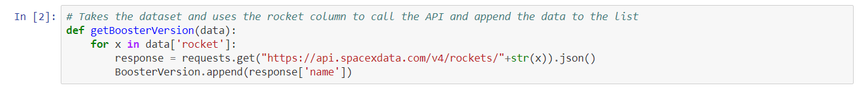
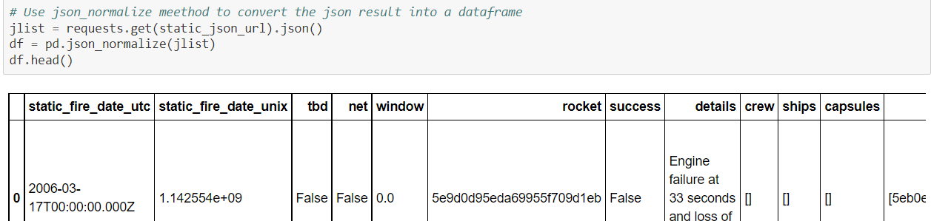
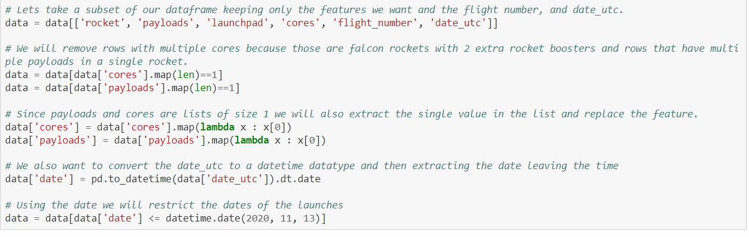
Data Collection – SpaceX API
1. Collecting the data with API call
2. Converting to data frame with help of JSON
3. Updating columns and rows (pre-processing)
4. Filtering the data to keep only Falcon 9 launches
5. Convert the data to csv file with name ‘dataset_part_1.csv’
GitHub repo: https://github.com/yousefhosam-b/IBM_SpaceX_Capstone_Project/tree/main/1.%20spacex-data-collection-api
8

Slide 9
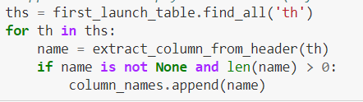
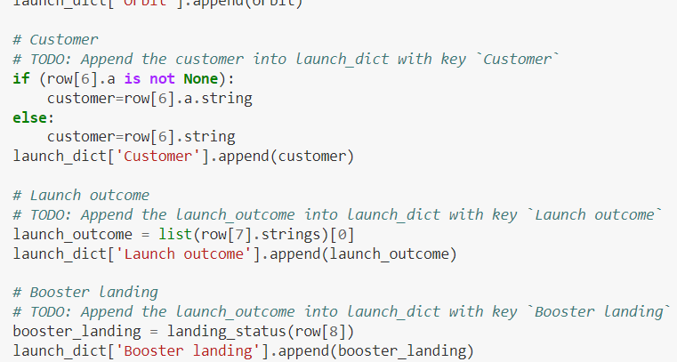
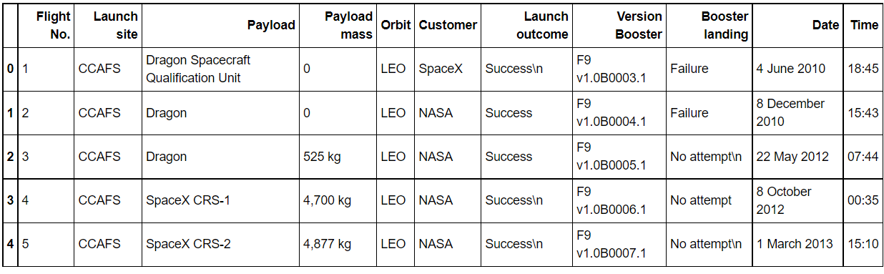
GitHub repo: https://github.com/yousefhosam-b/IBM_SpaceX_Capstone_Project/tree/main/2.%20webscraping
Data Collection - Scraping
1. Creating the BeautifulSoup object
2. Getting column names
3. Creating the launch_dict
4. Converting to final data frame
5. Convert the data to csv file with name ‘spacex_web_scraped.csv’

Slide 10
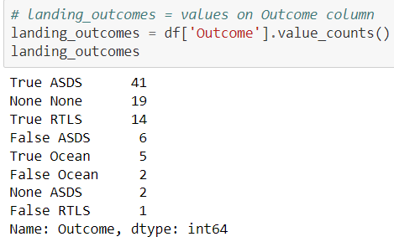
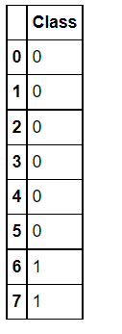
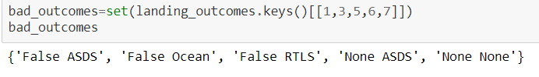
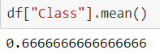
GitHub repo: https://github.com/yousefhosam-b/IBM_SpaceX_Capstone_Project/tree/main/3.%20spacex-data-wrangling
Data Wrangling
1. Loading the data set
3. Finding the bad outcomes
2. Creating landing outcomes
4. Presenting outcomes as 0 and 1
5. Determining the success outcome
6. Convert the data to csv file with name ‘dataset_part_2.csv’

Slide 11
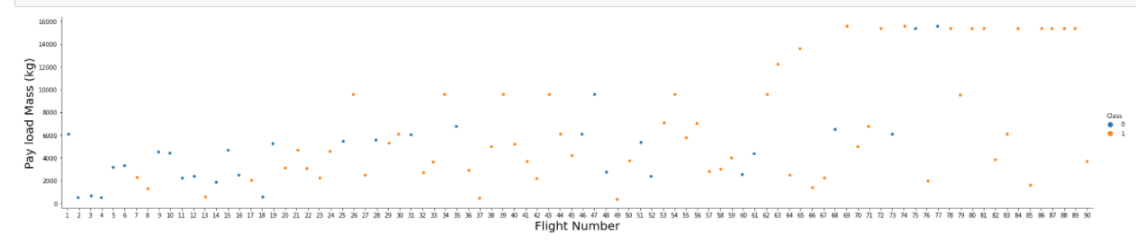
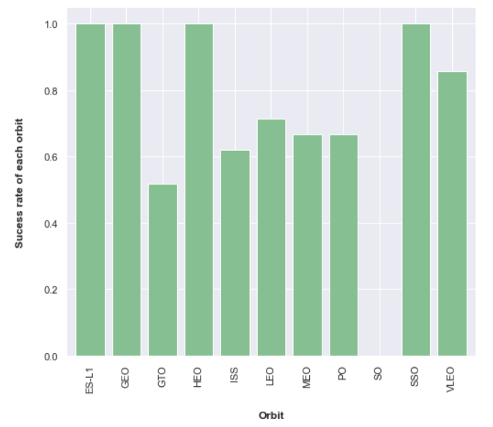
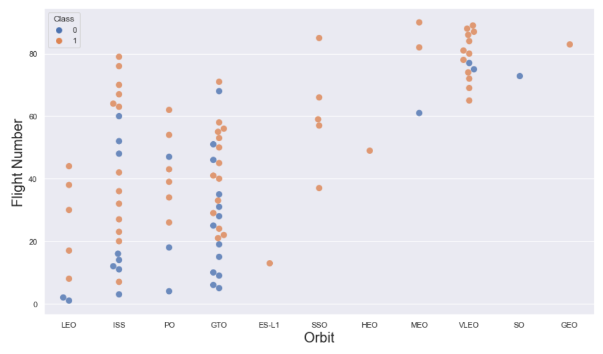
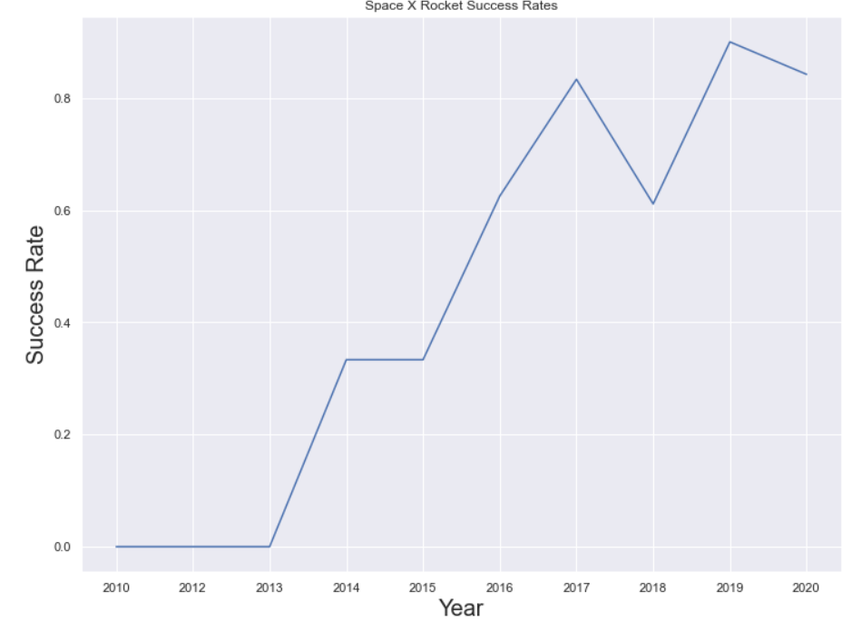
GitHub repo: https://github.com/yousefhosam-b/IBM_SpaceX_Capstone_Project/tree/main/5.%20eda-dataviz
EDA with Data Visualization
Categorial plot between Flight number and Pay load mass (kg)
Bar chart between Orbit and Success rate of each orbit
Line chart between Year and Success rate
Scatter plot between Orbit and Flight number

Slide 12
GitHub repo: https://github.com/yousefhosam-b/IBM_SpaceX_Capstone_Project/tree/main/4.%20eda-sql
EDA with SQL
I used SQL queries to answer the following questions:
Display the names of the unique launch sites in the space mission
Display 5 records where launch sites begin with the string 'CCA'
Display the total payload mass carried by boosters launched by NASA (CRS)
Display average payload mass carried by booster version F9 v1.1
List the date when the first successful landing outcome in-ground pad was achieved
List the names of the boosters which have success in drone ship and have payload mass greater than 4000 but less than 6000
List the total number of successful and failure mission outcomes
List the names of the booster_versions which have carried the maximum payload mass. Use a subquery
List the failed landing_outcomes in drone ship, their booster versions, and launch site names for the in year 2015
Rank the count of landing outcomes (such as Failure (drone ship) or Success (ground pad)) between the date 2010-06-04 and 2017-03-20, in descending order

Slide 13
Build an Interactive Map with Folium
folium.Marker() was used to create marks on the maps.
folium.Circle() was used to create a circles above markers on the map.
folium.Icon() was used to create an icon on the map.
folium.PolyLine() was used to create polynomial line between the points.
folium.plugins.AntPath() was used to create animated line between the points.
markerCluster() was used to simplify the maps which contain several markers with identical coordination.
GitHub repo: https://github.com/yousefhosam-b/IBM_SpaceX_Capstone_Project/tree/main/6.%20launch-site-location

Slide 14
Build a Dashboard with Plotly Dash
Dash and html components were used as they are the most important thing and almost everything depends on them, such as graphs, tables, dropdowns, etc.
Pandas was used to simplifying the work by creating dataframe.
Plotly was used to plot the graphs.
Pie chart and scatter chart were used to for plotting purposes.
Rangeslider was used for payload mass range selection.
Dropdown was used for launch sites.
GitHub repo: https://github.com/yousefhosam-b/IBM_SpaceX_Capstone_Project/tree/main/7.%20dashboard

Slide 15
Predictive Analysis (Classification)
1. Building the model
Create column for the class
Standardize the data
Split the data info train and test sets
Build GridSearchCV model and fit the data
2. Evaluating the model
Calculating the accuracies
Calculating the confusion matrixes
Plot the results
3. Finding the optimal model
Find the best hyperparameters for the models
Find the best model with highest accuracy
Confirm the optimal model
GitHub repo: https://github.com/yousefhosam-b/IBM_SpaceX_Capstone_Project/tree/main/8.%20machine-learning-prediction

Slide 16
Results
Exploratory data analysis results
Interactive analytics demo in screenshots
Predictive analysis results

Slide 17


Slide 18
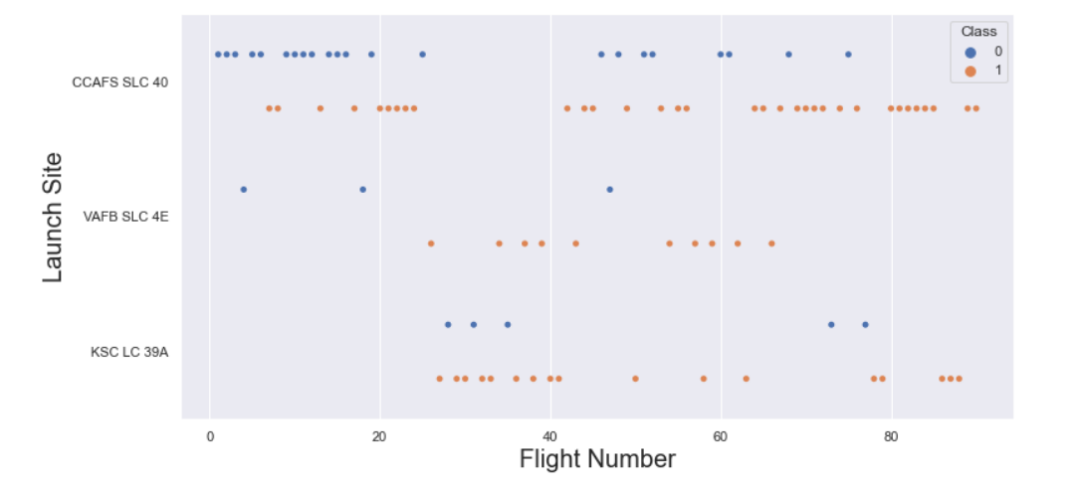
Flight Number vs. Launch Site
With the increase of flight number, the success rate is increasing as well in the launch sites

Slide 19
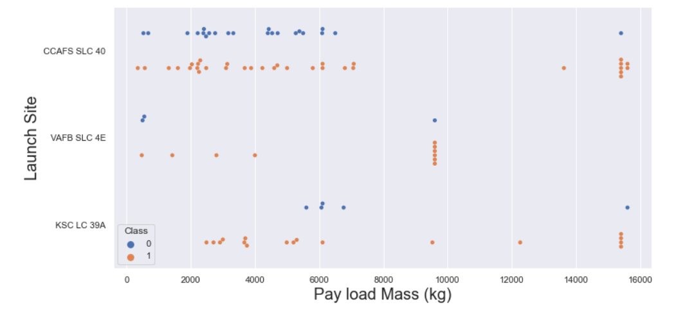
Payload vs. Launch Site
With the increase of Pay load Mass, the success rate is increasing as well in the launch sites

Slide 20
Success Rate vs. Orbit Type
ES-L1, GEO, HEO, and SSO have a success rate of 100%
SO has a success rate of 0%

Slide 21
Flight Number vs. Orbit Type
It’s hard to tell anything here, but we can say there is no actual relationship between flight number and GTO.

Slide 22
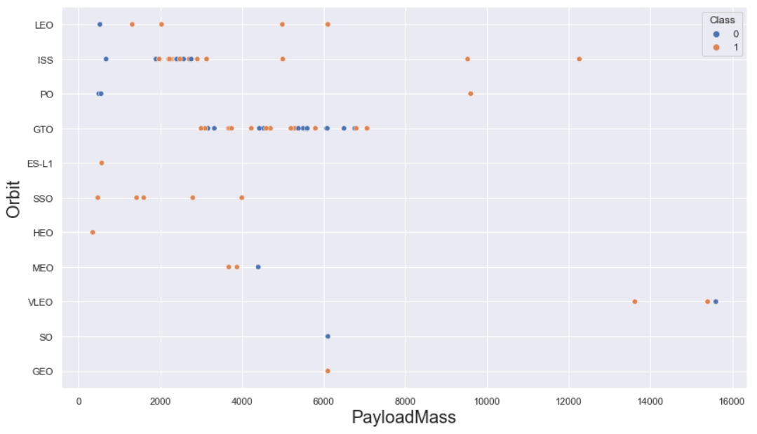
Payload vs. Orbit Type
First thing to see is how the Pay load Mass between 2000 and 3000 is affecting ISS.
Similarly, Pay load Mass between 3000 and 7000 is affecting GTO.

Slide 23
Launch Success Yearly Trend
Since the year 2013, there was a massive increase in success rate. However, it dropped little in 2018 but later it got stronger than before.

Slide 24
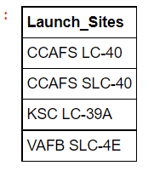
All Launch Site Names
We can get the unique values by using “DISTINCT”

Slide 25
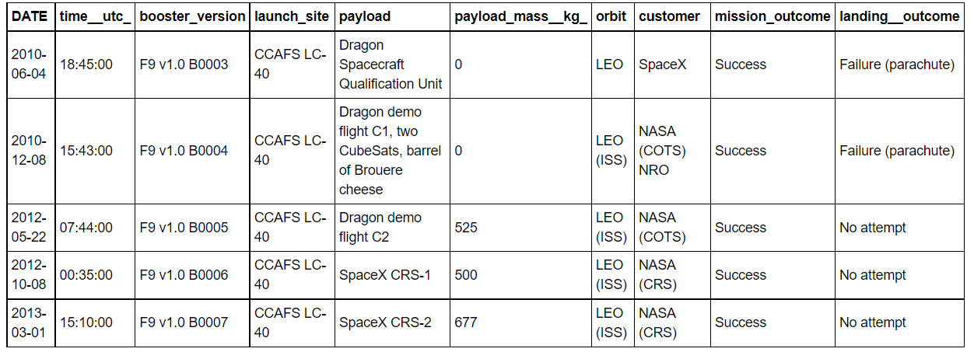
Launch Site Names Begin with 'CCA'
We can get only 5 rows by using “LIMIT”

Slide 26
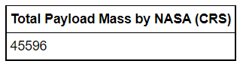
Total Payload Mass
We can get the sum of all values by using “SUM”

Slide 27
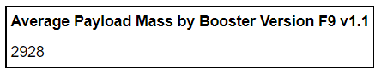
Average Payload Mass by F9 v1.1
We can get the average of all values by using “AVG”

Slide 28
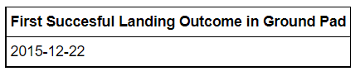
First Successful Ground Landing Date
We can get the first successful data by using “MIN”, because first date is same with the minimum date

Slide 29
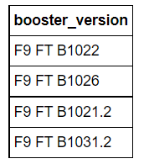
Successful Drone Ship Landing with Payload between 4000 and 6000
The payload mass data was taken between 4000 and 6000 only, and the landing outcome was determined to be “success drone ship”

Slide 30
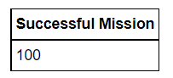
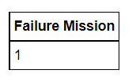
Total Number of Successful and Failure Mission Outcomes
We can get the number of all the successful mission by using “COUNT” and LIKE “Success%”
We can get the number of all the failure mission by using “COUNT” and LIKE “Failure%”

Slide 31
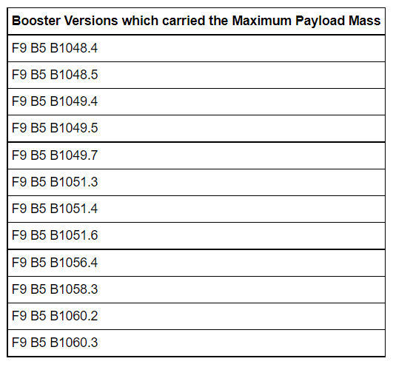
Boosters Carried Maximum Payload
We can get the maximum payload masses by using “MAX”

Slide 32
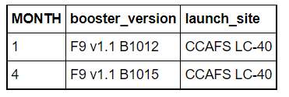
2015 Launch Records
We can get the months by using month(DATE) and in the WHERE function we assigned the year value to “2015”

Slide 33
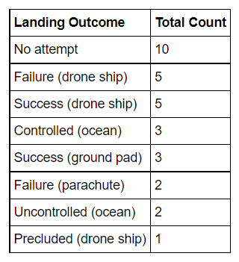
Rank Landing Outcomes Between 2010-06-04 and 2017-03-20
By using “ORDER” we can order the values in descending order, and with “COUNT” we can count all numbers as we did previously

Slide 34


Slide 35
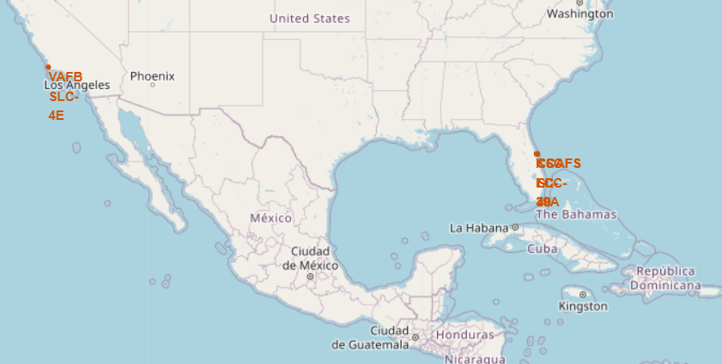
All Launch Sites’ Location Markers
All the launches are near USA, Florida, and California

Slide 36
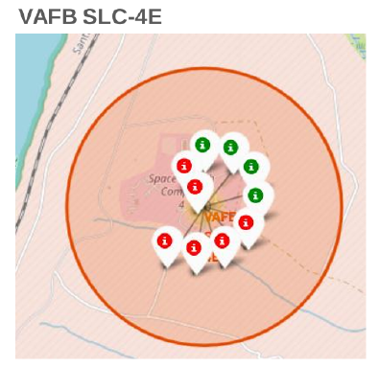
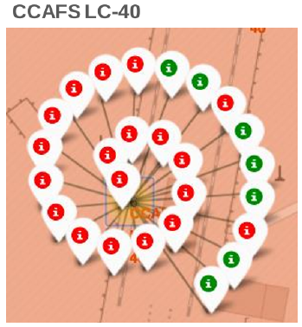
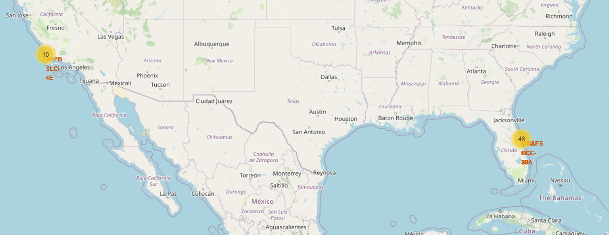
Color-labeled Launch Outcomes
Green means successful
Red means Failure

Slide 37
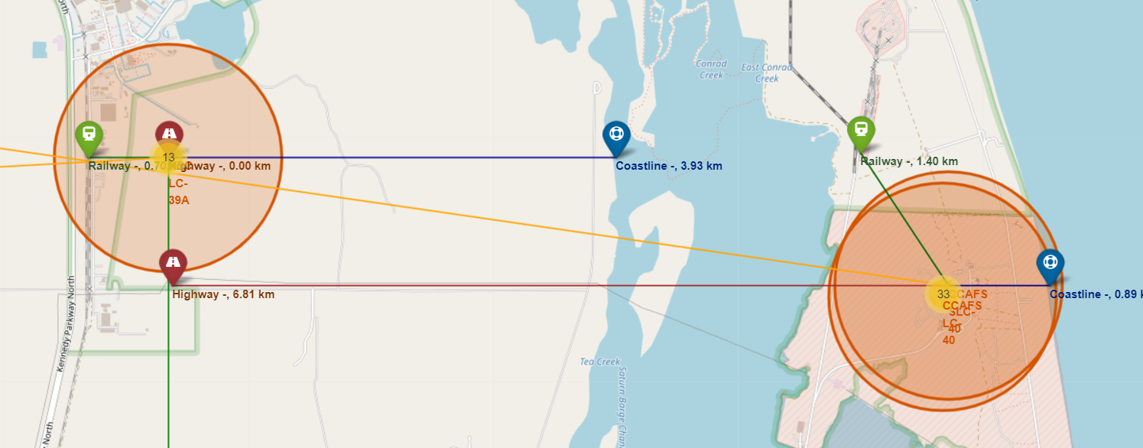
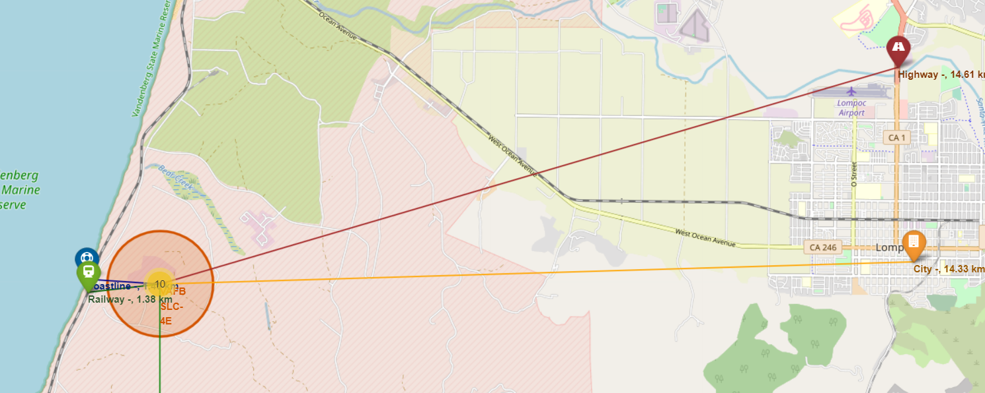
Launch Sites to its Proximities
All distances from launch sites to its proximities, they weren’t far from railway tracks.

Slide 38


Slide 39
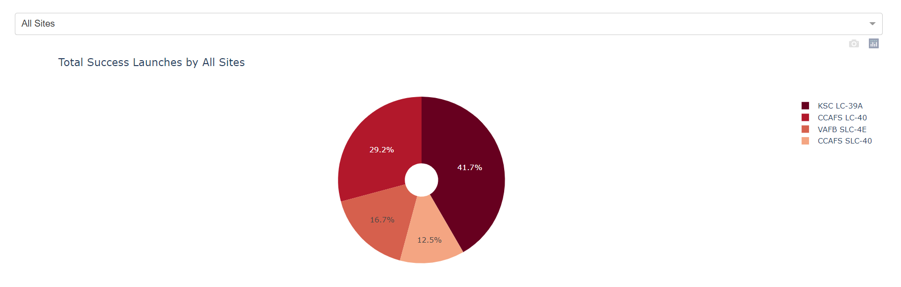
Launch Success Count
KSC LC-39A has the highest success score with 41.7%
CCAFS LC-40 comes next with 29.2%
Finally, VAFB SLC-4E and CCAFS SLC-40 with 16.7% and 12.5% respectively

Slide 40
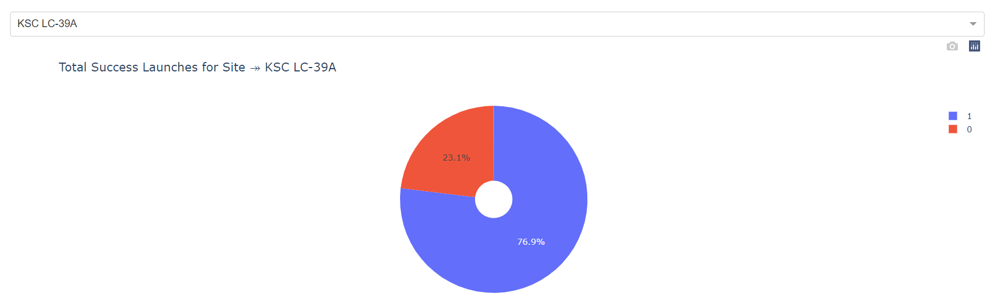
Launch Site with Highest Score
KSC LC-39A has the highest score with 76.9% with payload range of 2000 kg – 10000 kg, and FT booster version has the highest score

Slide 41
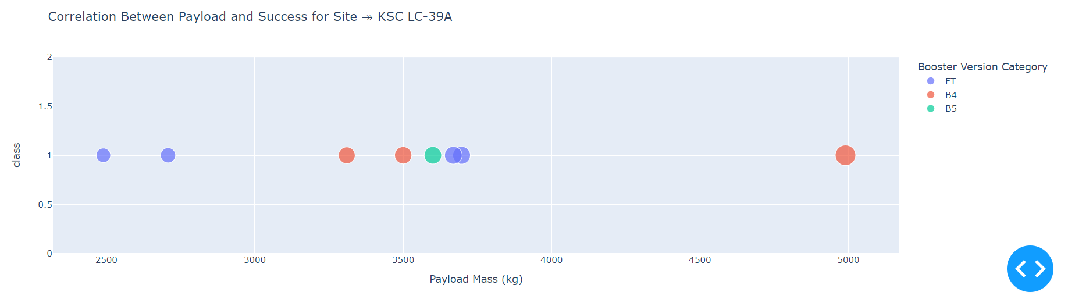
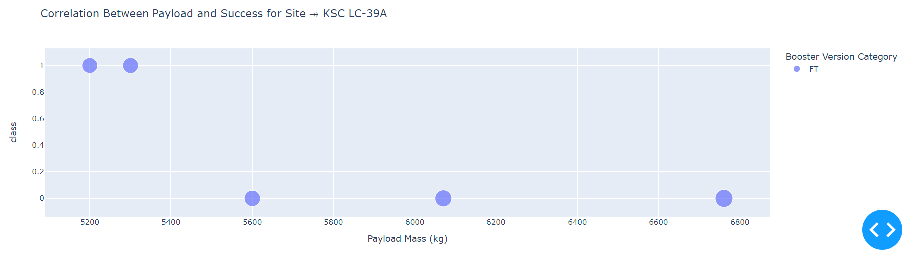
Payload vs. Launch Outcome
Payload 0 kg – 5000 kg (first half)
Payload 6000 kg – 10000 kg (second half)

Slide 42


Slide 43
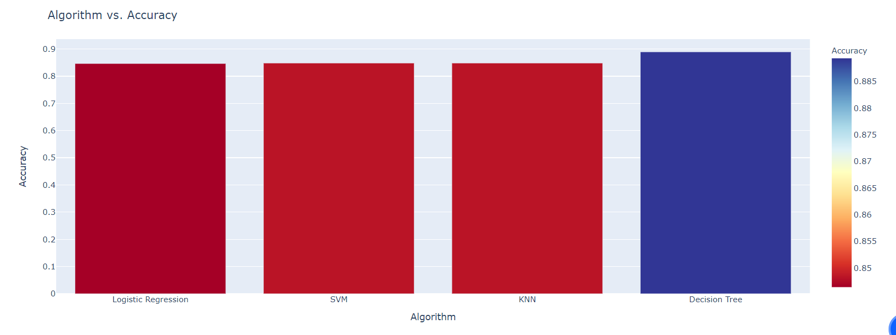
Classification Accuracy
Decision Tree has the highest accuracy with almost 0.89, then comes the remaining models with almost same accuracy of 0.84

Slide 44
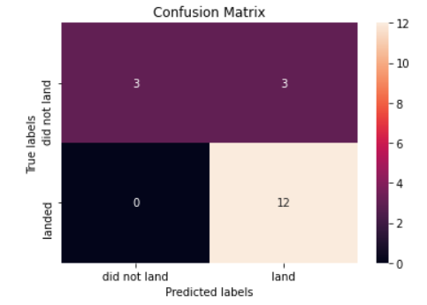
Confusion Matrix
Sensitivity = 1.00, formula: TPR = TP / (TP + FN)
Specificity = 0.50, formula: SPC = TN / (FP + TN)
Precision = 0.80, formula: PPV = TP / (TP + FP)
Accuracy = 0.83, formula: ACC = (TP + TN) / (P + N)
F1 Score = 0.89, formula: F1 = 2TP / (2TP + FP + FN)
False Positive Rate = 0.50, formula: FPR = FP / (FP + TN)
False Discovery Rate = 0.20, formula: FDR = FP / (FP + TP)
True Negative (TN)
False Positive (FP)
False Negative (FN)
True Positive (TP)

Slide 45
Conclusions
We found the site with highest score which was KSC LC-39A
The payload of 0 kg to 5000 kg was more diverse than 6000 kg to 10000 kg
Decision Tree was the optimal model with accuracy of almost 0.89
We calculated the launch sites distance to its proximities

Slide 46
Appendix
All codes can be found on my GitHub
GitHub repo: https://github.com/yousefhosam-b/IBM_SpaceX_Capstone_Project

Slide 47


